Slide 1
Damian O’Neill (Oranga Tamariki) – Understanding young people with high needs transitioning out of care
Míša Urbanová, Valmai Copeland
Oranga Tamariki Engagement Survey with Partners Providing Social Services

Slide 2
Background
Oranga Tamariki is working with some 500 partner organisations that have contracts to provide social services (partners).
We want to better understand and measure the relationship with these partners and to understand how we can strengthen the relationships.
Evidence Centre conducted a survey to capture the views of these partners in a structured and quantifiable way that can be tracked over time.
This is the first survey and will be used as a baseline for following years.
This was the first

Slide 3
About the survey
Conducted in November 2020.
214 partners took part in an online survey (40% of partners invited).
77 Kaupapa Māori
20 Pacific
8 iwi partners interviewed kanohi-ki-te-kanohi.

Slide 4
Response by PfO region
Te Tai Tokerau 6 out of 30 (20%)
Auckland 35 out of 100 (35%)
Central 61 out of 131 (47%)
Midlands 40 out of 89 (45%)
Southern 42 out of 91 (26%)
National or multiple 27 out of 78
Unassigned 3 out of 13

Slide 5
Context: what was going on at the time
New Zealand moved to alert level 1 after the first lockdown.
Royal Commission of Inquiry into Abuse in Care and the Waitangi Tribunal’s inquiry into Oranga Tamariki practice
Ongoing media coverage

Slide 6
FINDINGS

Slide 7
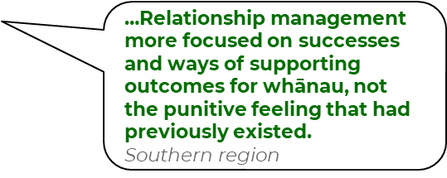
Engagement and satisfaction
Oranga Tamariki is engaging and interacting the same (53%) or better (39%) than when it was established in 2017.
6 in 10 partners are satisfied with their current interactions with Oranga tamariki as a whole.
Partners most commonly interact and are most satisfied with the Partnering for Outcomes group.

Slide 8
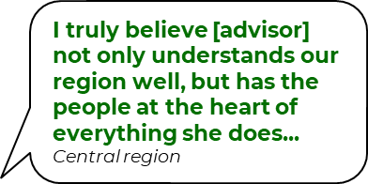
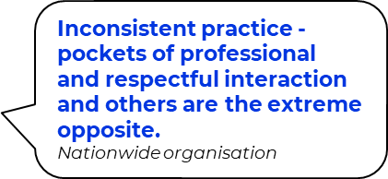
Staff essential to maintaining and improving relationships
Partners appreciate staff who
Have good understanding of the local situation.
value and want to support the work that the partners do,
and who work in a way that is not contractual but a true partnership.
Feedback mentioned how variable the engagement with Oranga Tamariki can be.

Slide 9
Relationship variation
Partners overall feel more valued and supported by local/regional staff than by national office.
Interestingly, iwi partners in the interviews expressed that they felt more supported by national office, who was seen as more accessible and responsive.

Slide 10
Engagement, satisfaction and relationships
Questions for webinar participants:
Do you have any comments on these results so far? Would you like to share an example or short story of your experience regarding relationship with Oranga Tamariki?

Slide 11
Communication
Communication is generally rated positively:
7 in 10 found communication clear, and provided proactively and timely.
Communication during COVID 19 lockdown was praised.
Areas for improvement:
Inconsistency in the information received Messaging that comes from National Office can be contradictory to local/regional office advice.
Amount of communication is overwhelming for some.

Slide 12
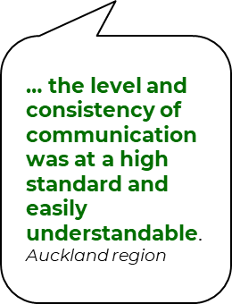
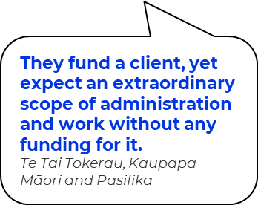
Expectations and funding
Oranga Tamariki is consistent and specific on what it expects of partners,
but only 3 in 10 partners agree that the amount of funding is sufficient to meet their contractual obligations, including relevant overheads.

Slide 13
Communication and funding
Question for webinar participants:
Do you have any further comments on these findings or an example to share?
Would you

Slide 14
Kaupapa Māori partners
The results for partners who identified as Kaupapa Māori partners did not markedly differ from the overall results,
…but some unique themes emerged from the interviews.

Slide 15
Interviews with iwi partners
Overall, engagement and communication with Oranga Tamariki have improved since 2017.
Barriers to satisfaction include a deficiency of mātauranga Māori and kaupapa Māori knowledge across staff and the presence of institutionalised racism.
There are systemic inequities impacting on provider practice, with positive outcomes reported when Oranga Tamariki recognises and makes a commitment to supporting kaupapa Māori practices and models.

Slide 16
Interviews with iwi partners
Concerns were raised by most iwi partners about what true partnership means within the relationship between Oranga Tamariki and iwi.
All participants expressed a need for Oranga Tamariki to acknowledge iwi partners as equal partners in accordance with Te Tiriti o Waitangi. They stressed that equitable partnership requires the sharing of power, vision, purpose, funding and decision-making. Most participants suggested that this is not happening.
Iwi partners suggest Oranga Tamariki focus on the building of respectful relationships, practice and relinquishing power.

Slide 17
Kaupapa Māori and iwi partners
Questions for webinar participants:
Do you have any comments on these findings or an example to share?

Slide 18
Thank you
We plan to repeat this survey later this year to track change and we would like to invite you to participate again ☺
Any questions?

Slide 19
READ OUR RESEARCH:
Check out the Research web page at https://www.orangatamariki.govt.nz/about-us/research/our-research/
EMAIL US:
research@ot.govt.nz

Slide 20
Engagement Survey with Partners Providing Social Services 2020
Response to the findings from Oranga Tamariki
Peter Galvin, General Manager Partnerships
Martin Rodgers, Manager Sector Engagement

Slide 21
Variation in relationships between National and Regional/Local offices
To improve how we work with iwi, Māori and other organisations, we have been applying:
the section 7AA expectations of the Oranga Tamariki Act
the Te Arawhiti guidelines and broader partnering approaches.
Examples include how we are working in key programmes such as Whānau Care and Intensive Response.
We are finalising a set of ‘partnership principles’ that we will apply alongside other changes we are making in response to the recent reviews.

Slide 22
Systemic inequities impacting on practice of Māori partners
We are now in the process of shifting to a Māori-centred position to our practice that always sees tamariki in the context of the whānau.
This will require significant change across Oranga Tamariki and will include an increased focus on local solutions developed with and delivered by partners.
You can read our current guidance around working effectively with Māori on the Oranga Tamariki Practice Centre.

Slide 23
A need for equitable partnerships in accordance with Te Tiriti o Waitangi
Oranga Tamariki has set up a Treaty Response Unit, which is supporting Oranga Tamariki to ensure its policies, practices and services meets 7AA Quality Assurance Standards.
We embrace strategic partnerships and enhanced relationships with iwi and Māori organisations, which enable us to develop new ways of working to better support tamariki Māori and their whānau.
We have also changed our procurement approach to provide for early discussions with iwi and Māori organisations to understand their interests.
We have established a new Pou Tikanga role within the Ministry to be the organisation’s cultural leader.

Slide 24
Consistency and amount of communication
We are taking a more ‘regionally-led, nationally supported’ approach to how we work.
Our regional teams will be focused on developing and supporting relationships with our partners.
We know we need to be more joined up and coordinated in how we work internally.

Slide 25
There are pockets of good practice and these need to be transferred
We are developing a new strategy and action plan to enable all tamariki and their whānau to thrive with the support of their communities, iwi and hapū.
Engagement on this strategy will provide opportunities for partners to influence the vision and direction ahead for Oranga Tamariki.
We have been looking to learn from sites where things are going well, and to understand how that can be adapted for other places in a way that’s appropriate to local circumstances.

Slide 26
There is lack of funding to achieve desired outcomes
Recent responses have included increasing the proportion of long-term contracts, increasing the proportion of funding that goes to iwi and Māori service providers, increasing the baseline funding for services, and adjusting our costing models for new services to better reflect the full cost of providing social services.
The Workforce Working Group has commissioned a piece of research into the workforce related cost of kaupapa Māori and Pacific models of service delivery.
Oranga Tamariki is co-leading the social sector commissioning programme with the Ministry of Social Development.
We are also continuing to provide support to the parties involved in the pay equity claims raised by the Public Service Association.

